Slide 1
BeliN - A Novel Corpus for Bengali Religious News Headline Generation using contextual feature fusion
ALINA MARYAM MUGHAL
FA24-RAI-002

Slide 2
Introduction
Problem Statement:
Headline generation for Bengali religious news is under-explored.
Existing methods ignore contextual features (sentiment, category, aspect), limiting effectiveness.
Solution:
BeliN Corpus: First large-scale dataset for Bengali religious news (2,520 articles).
MultiGen Approach: Integrates article content with category, aspect, and sentiment for richer context.

Slide 3
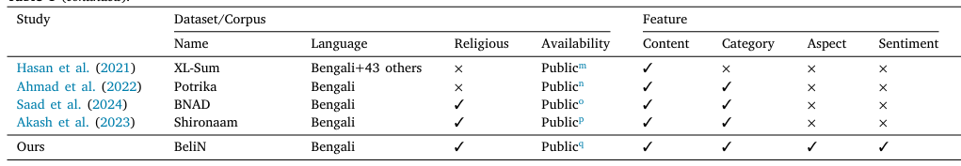
Existing Work (Limitations)
Key Contributions:
New dataset (BeliN).
Multi-input feature fusion (MultiGen).
State-of-the-art transformer models (BanglaT5, mBART, mT5, mT0).

Slide 4
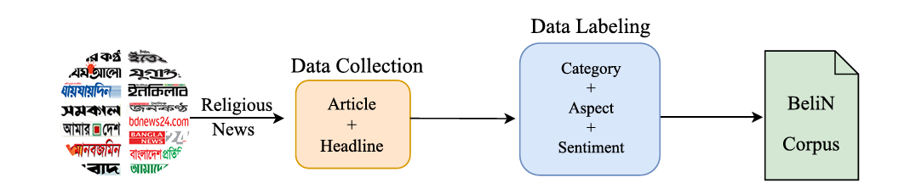
BeliN Corpus Overview
2,520 articles.
Category distribution: Islam (79.4%), Hinduism (9.6%), Others (8.7%).
Sentiment: 68% Positive, 18% Negative, 14% Neutral.

Slide 5
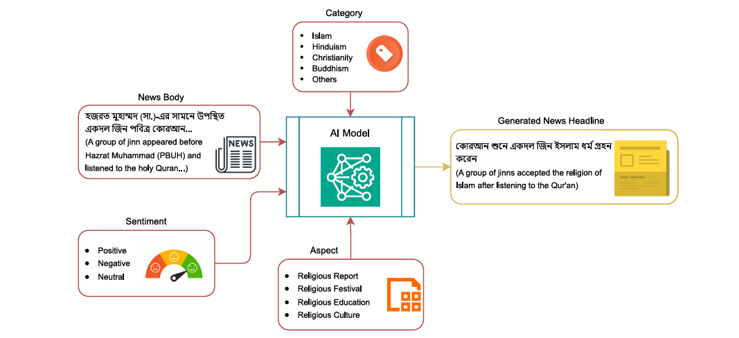
MultiGen Approach

Slide 6
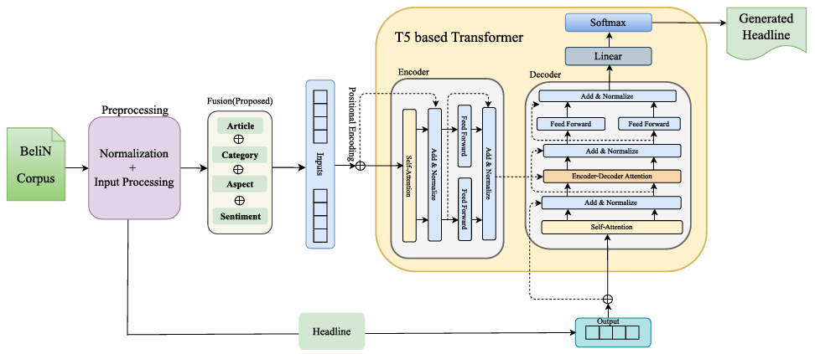
Model Architecture

Slide 7
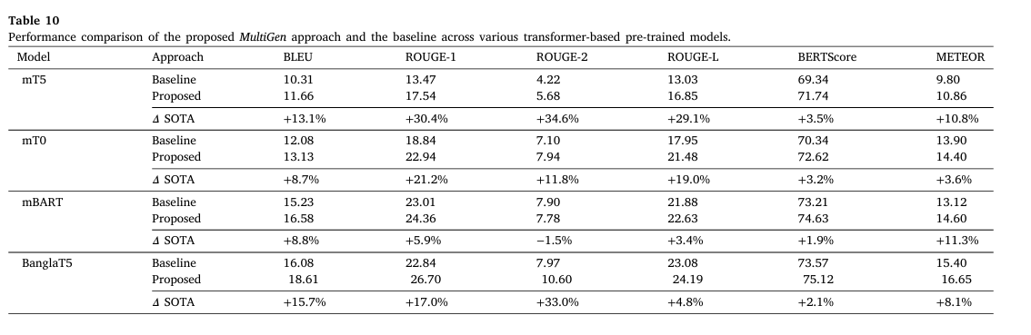
Experimental Results
Metrics: BLEU, ROUGE, BERTScore, METEOR.
Key Findings: BanglaT5 outperforms others (BLEU: 18.61 vs. 16.08 baseline). MultiGen improves all metrics (e.g., ROUGE-L: +4.8%).

Slide 8
Conclusion
Future Work:
Including a wider variety of topics and domains in the dataset.
Leveraging Large Language Models (LLMs) for real-time headline generation across multiple languages, including Bengali.
Summary:
BeliN is the first Bengali religious news corpus with multi-context features.
MultiGen outperforms baselines by integrating category, aspect, and sentiment.

Slide 9

THANK YOU

